Slide 1
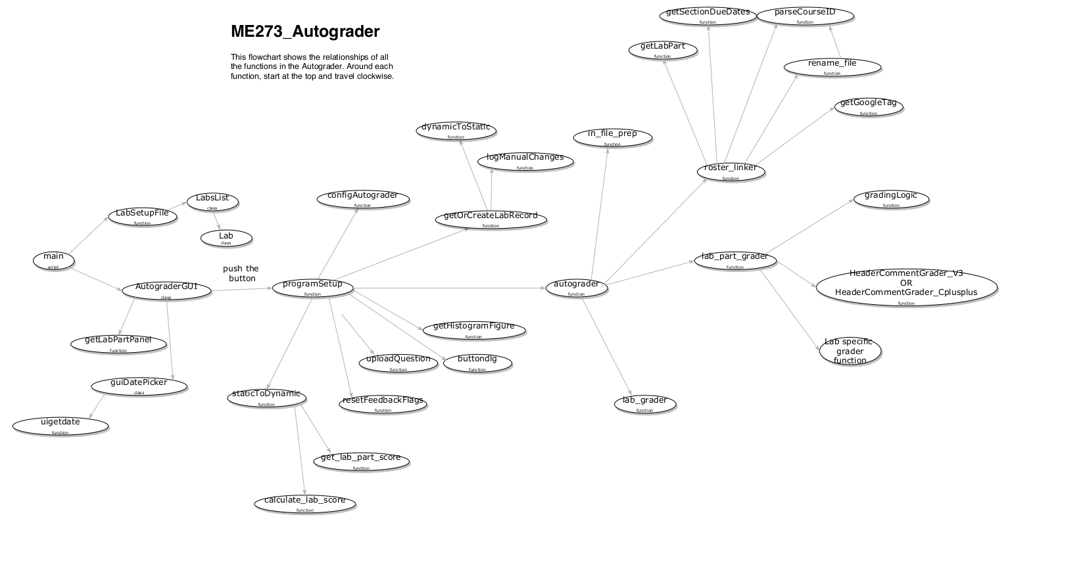
This defines the default parameters for each assignment such as reference due date, number and name of tasks for each lab, etc. This is edited manually, outside of any program.
Normally these never need to be changed or accessed by the user.
calls
calls
“grade”
These control GUI appearance, will likely never need to be modified.

Slide 2
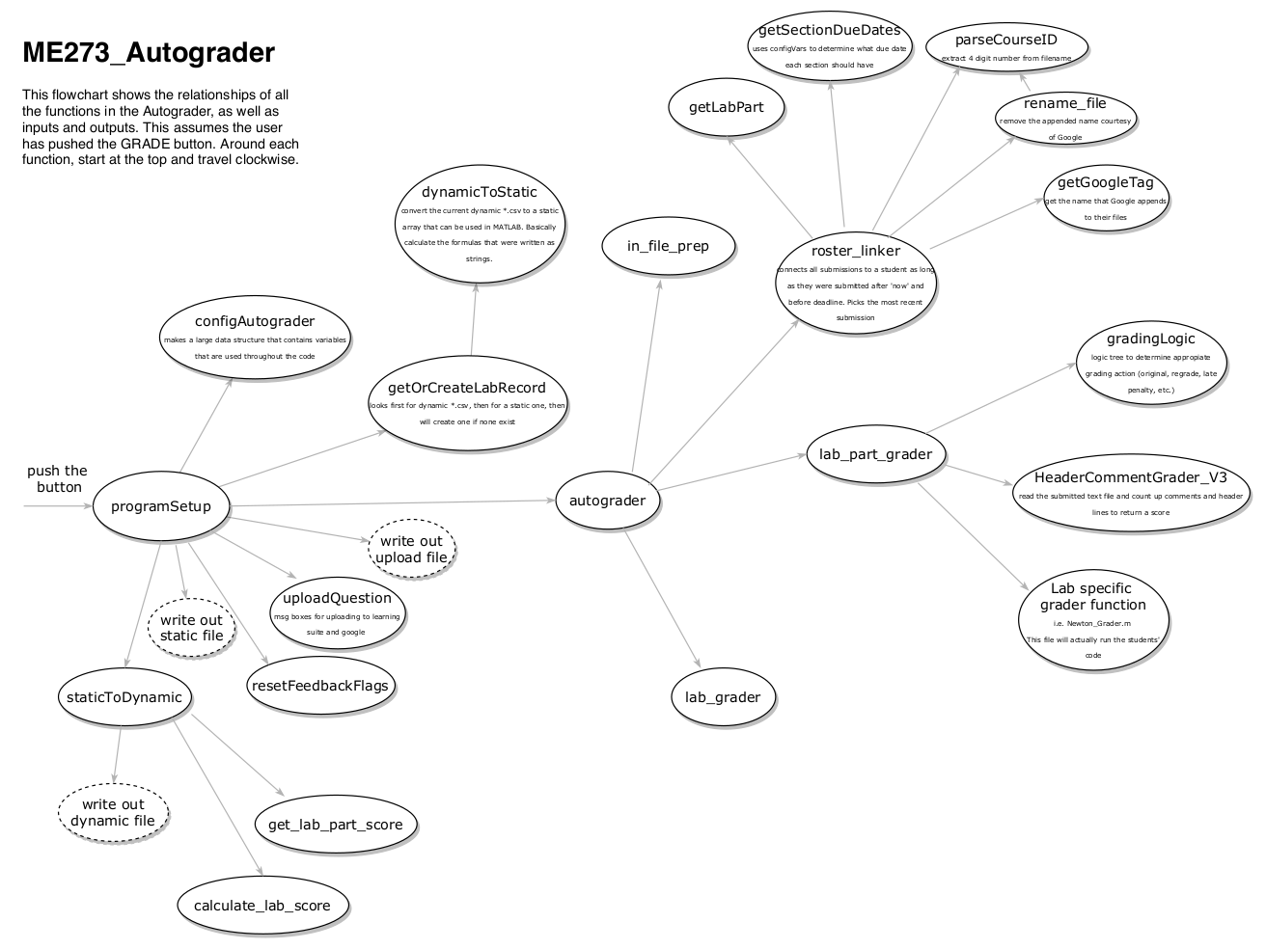
These assume a particular table format, which is definied in configAutograder. So if a column were added to the data table in configAutograder (for example, lab part weighting) this would need to be modified to handle that additional column.
Creates top dummy folder as a temp file repository. Jared H. never changed this.
Creates top dummy folder as a temp file repository. Jared H. never changed this.
Creates the data table, along with points for assignments, grade weights. If lab parts were weighted, the weights would be added here, but the class would also need to be edited to have a weight property for each lab (Lab class within LabSetup function)
1
2
3

